Slide 1
Project Presentation #1
Iris

Slide 2
Contents
00
01
02
03
04
05
06
07
Introduction
Objective
Dataset
Data Visualization
Statistical Analysis
Descriptive Statistics
Plot and Analysis
Inferential Statistic
Aumi Ichiki Personal Training 20XX

Slide 3
1
Introduction

Slide 4
Introduction
We are AI engineering hired by a client to investigate the relationship between advertising and sales of a product.
We are provided the datasets of sales of product in 200 different market, and advertising budgets for the product in three different media: TV, Radio and Newspaper.
If we determine that there is an association between advertising and sales, we can ask client to adjust.

Slide 5
2
Objective

Slide 6
Objective
Our goal is to develop an accurate model that can be used to predict sales on the basis of 3 media budgets.

Slide 7
3
Data virtualization

Slide 8
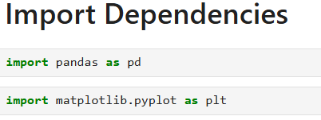
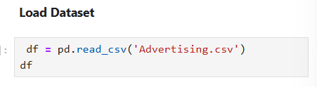
Data virtualization
First,We need to use numpy and Matplotlib to generate scatter plot graph.
In order to put the Advertising.csv, we should add df to determine the dataset.
BUSINESS NAME

Slide 9
4
Dataset

Slide 10
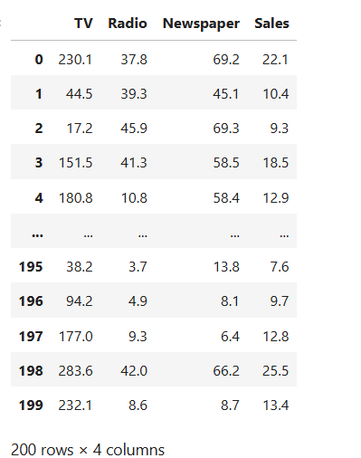
Dataset
This data provided by our client, shows that advertising speeds of three media: TV,Radio and Newspapers and sales.
The units of three features are in thousands of dollars.
Sales are the quantity of product sale at budget of three advertising in thousands of dollars.

Slide 11
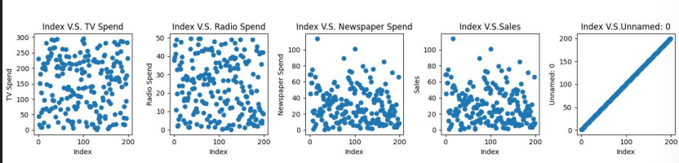
Dataset
Use for loop and plt. to create five scatter plot. X-axis for them are index from 0-200.Y-axis is feature.
According to the data, We can see that Unnamed:0 is a linear graph, so Unnamed:0 is same as Index, don’t need to analyze it. We should confirmed with Client that Unnamed is an extra feature and it’s not important, we should drop it.
TV looks like is most average sales.Newspaper might has a few potential outliers due to a few point are separated, but we need to prove it.
BUSINESS NAME

Slide 12
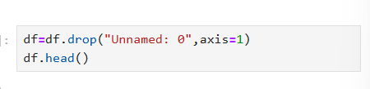
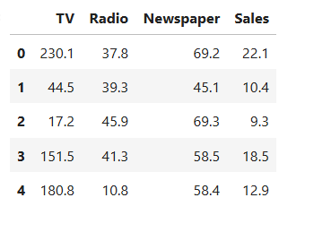
Dataset
For dropping Unnamed:0,we have to write:
Keep TV, Radio, Newspaper and sales
It also affect the df and scatter plot.

Slide 13
5
Statistical Analysis

Slide 14
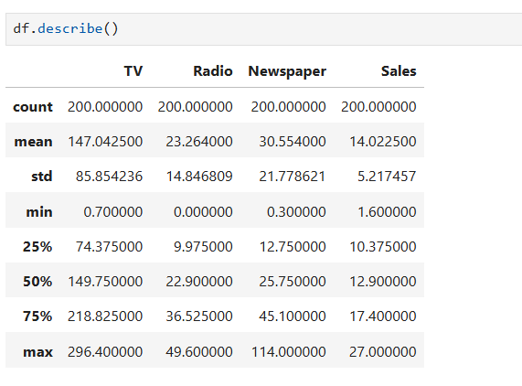
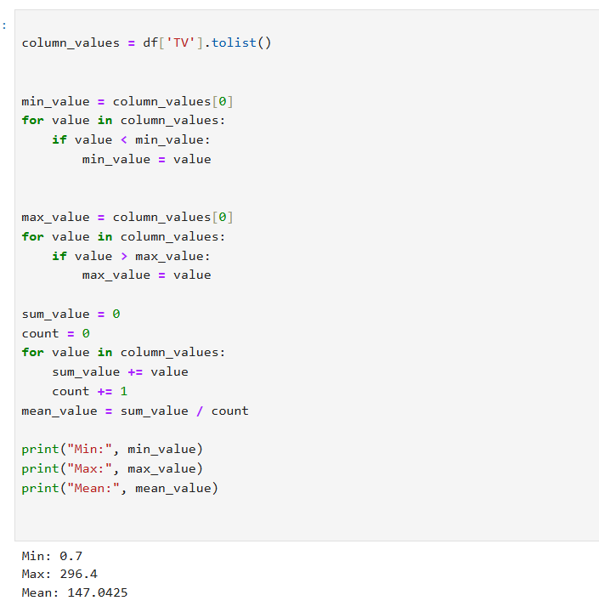
Statistical Analysis
We cannot just use scatter plot to make accurate decision or prediction.
We need Statistical Analysis to help us make more detail.
Statistical Analysis include mix,max,median,mode,mean.
Mean: average level of data.The sum of data divide the amount of numbers.
Median: median level of data, which divide data into two equal part.
Mode: most frequency number in the data,
Mean, Median and Mode are descriptive statistics-central tendency.
We use both methods to calculate mean, max and mean in hand and use df.describe

Slide 15
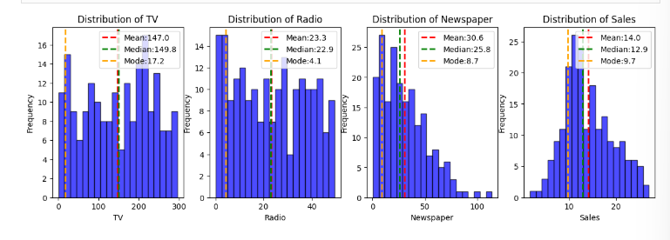
Histogram
We use Histogram to show mean,median and mode clearly for each teature and sales.
According to the Histogram, we can see that they spend lots of money in TV due to Mean and Median are very close.TV and Radio almost same.
Newspaper is not make sense due to its mode only 8.7, it might has outliers.

Slide 16
6
Descriptive Statistics

Slide 17
Interpret Quartiles & Interquartile Range
Min=Q0
25%=Q1
50%=Q2
75%=Q3
Max=Q4
IQR=Q3-Q1
Lower bound=Q1-1.5 X IQR
Upper Bound=Q3+1.5 x IQR

Slide 18
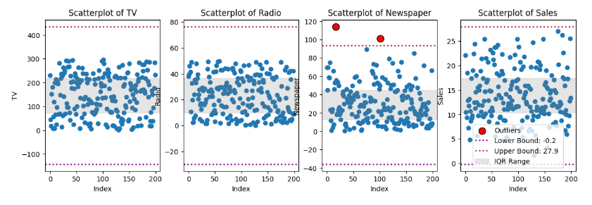
Denoise & Outlier
We use IQR, Lower Bound and Upper Bound to create scatter plot with lower bound and upper bound to show the outliers in red.
Between Lower bound and upper bound is the interval that not have outliers or noise.
Outliers can occur due to measurement errors, variability in the data .
Denoise: remove unwanted noise from data while preserving important information.
According to the Data, I observe that Newspaper has a few outliers that above upper bound, so it should be drop like Unnamed:0.

Slide 19
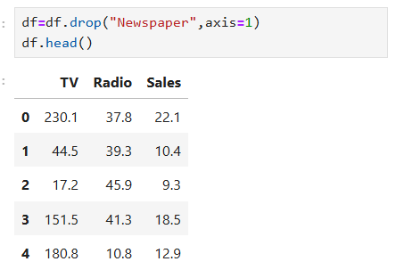
Drop Newspaper
For dropping Unnamed:0,we have to write:
Keep TV, Radio, Newspaper and sales

Slide 20


Dispersion
Dispersion is consist of various and standard deviation.
Variance:is a metric that quantifies the dispersion of a dataset.it represents the average of the squared deviation of data points from mean.
Larger variance—data points deviate more from the mean, greater spread.
Standard deviation: has the square root and count should minus 1.
High STD –more decentralized

Slide 21

7
Plot & Analysis

Slide 22
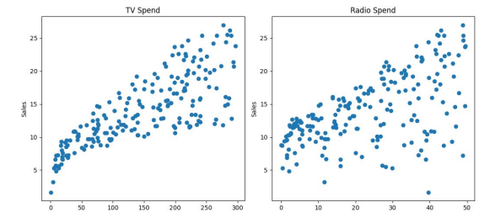
Plot and Analysis
We should make datas with x-axis is how much TV spend and compare to Sales, and how much Radio spend compare to Sales
According to the data, We observe that TV almost linear, but we need to use correlation to prove that it’s linear

Slide 23
8
Inferential Statistics

Slide 24

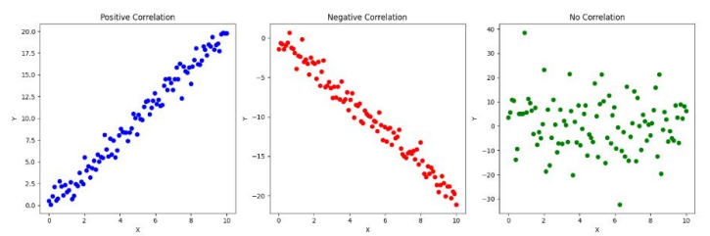
Correlation
We cannot use eyes to determine the relationship, we have to use correlation to prove that.
Correlation is linear relation,shows relationship, not causation. .It is a statistical concept to measure the strength and direction of relationship between two variables. We can understand whether there are changes.
Positive correlation: 1 variable increase, another one increase.(r=1)
Negative correlation:1 variable increase, another one decrease(r=-1)
No correlation: there is no linear relationship(r=0)

Slide 25
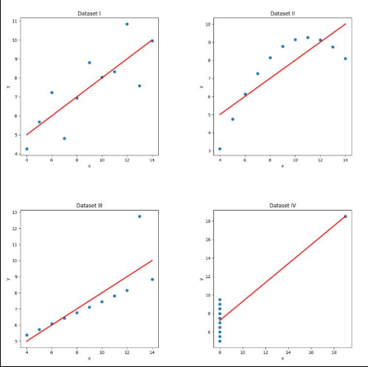
Anscombe’s Quartet
It consists four dataset that share statistical properties.They have same mean,variance, and correlation, but different graphical distribution or solution.

Slide 26
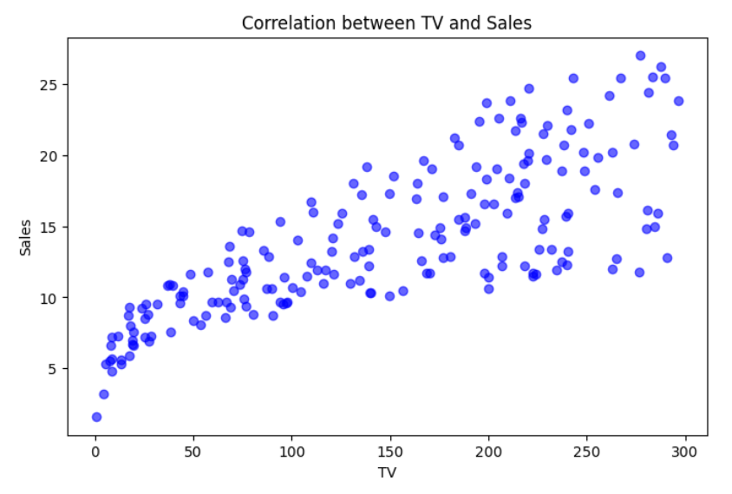
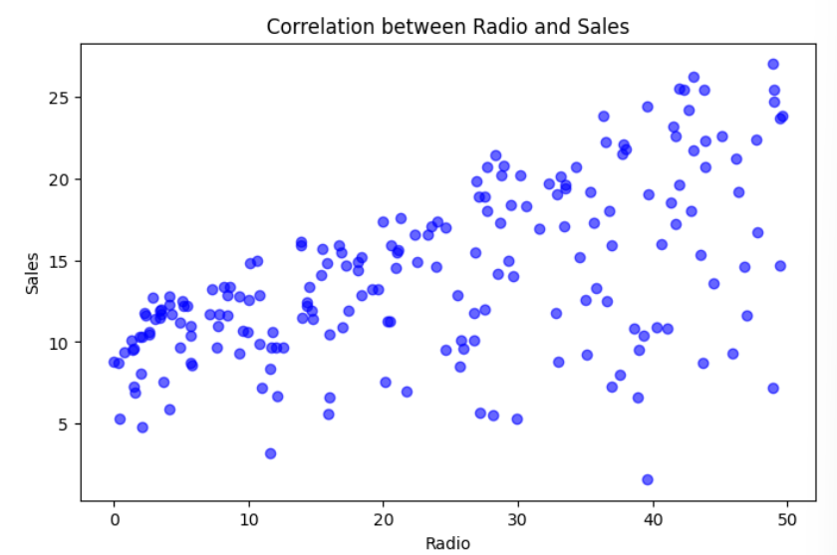
Correlation
According to the data, it shows that TV and sales are strong linear relationship.The Correlation between TV and Sales is 0.78.
The graph shows that Radio and sales not very linear, more separated.The Correlation between Radio and Sales is 0.58

Slide 27
Thank you! ! !
Iris

